Slide 1
Creative Content Management
Sequence , Collaboration And State Diagram
Presented By
1805077 - Kazi Ababil Azam
1805087- Fardin Anam Aungon

Slide 2
Estimation

Slide 3
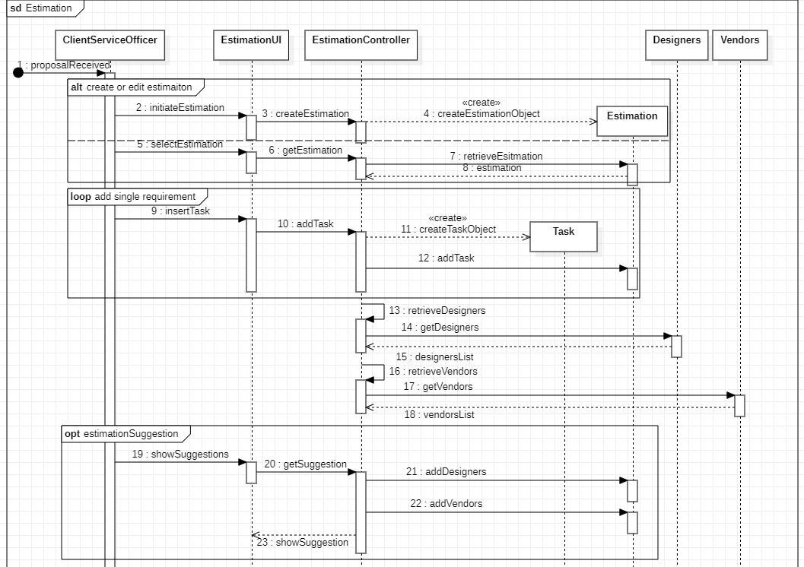

Client Service Officer

Slide 4
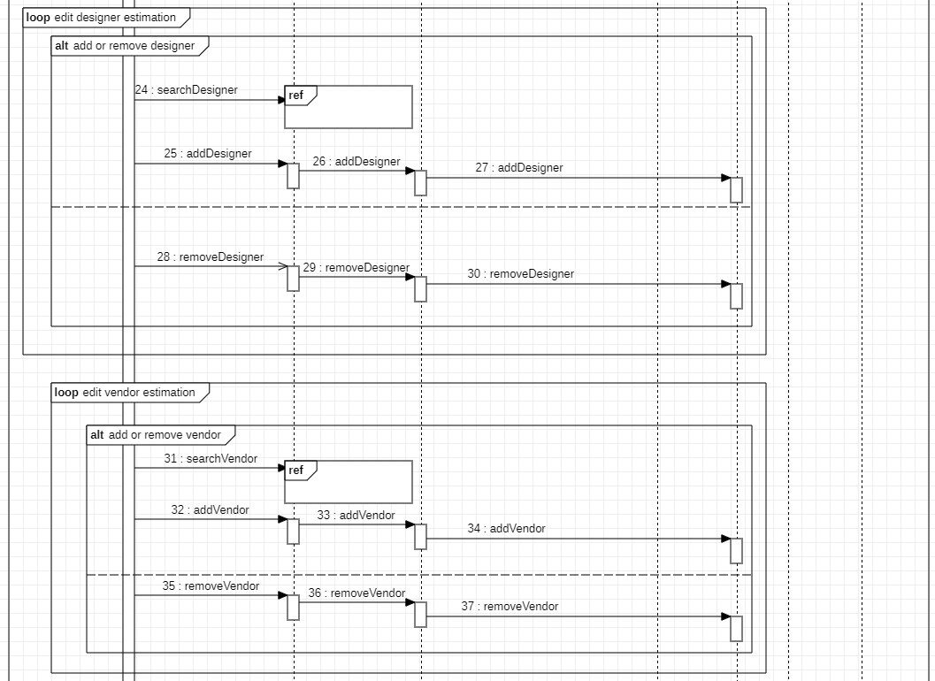
Search & Filter
Search & Filter

Slide 5
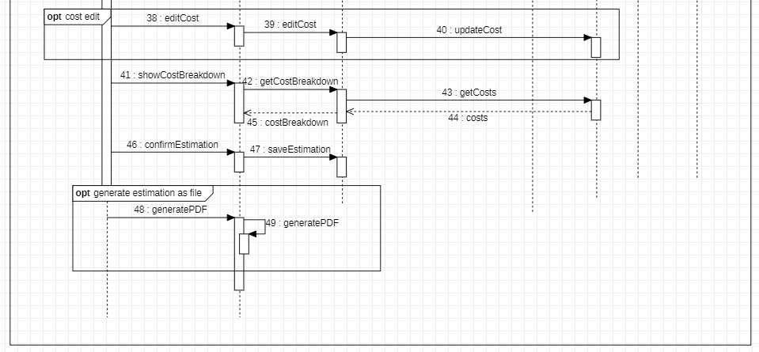

Slide 6
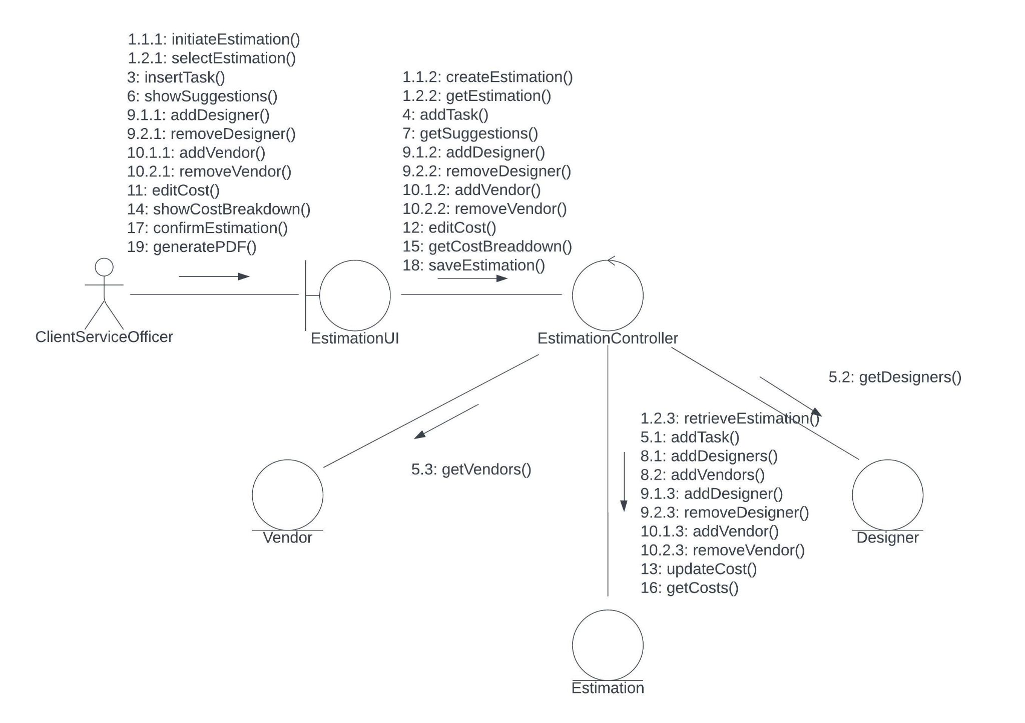

Slide 7
Project Creation

Slide 8
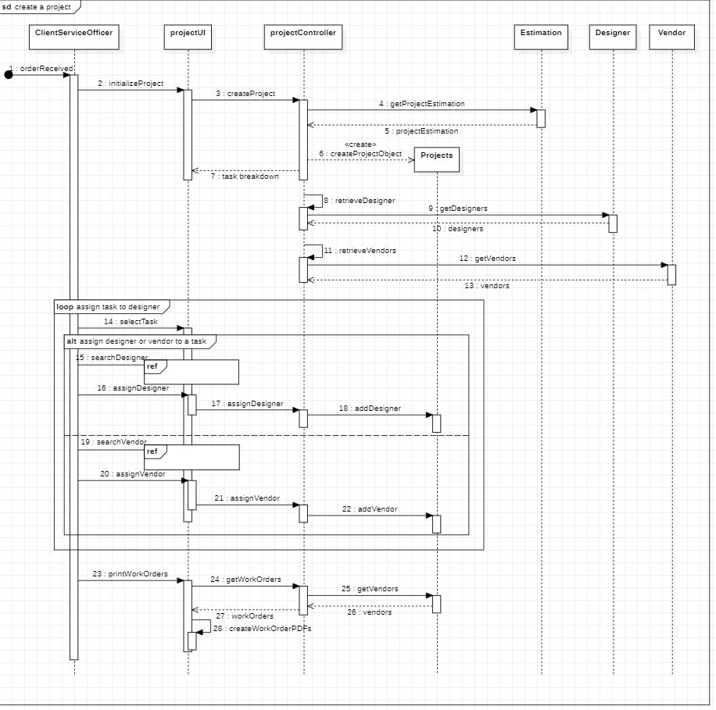
Client Service Officer
Search & Filter
Search & Filter

Slide 9
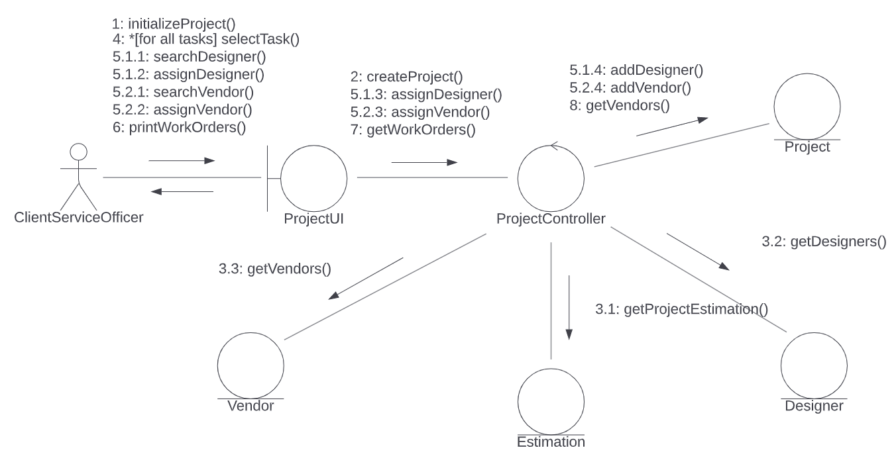

Slide 10
Task Update

Slide 11
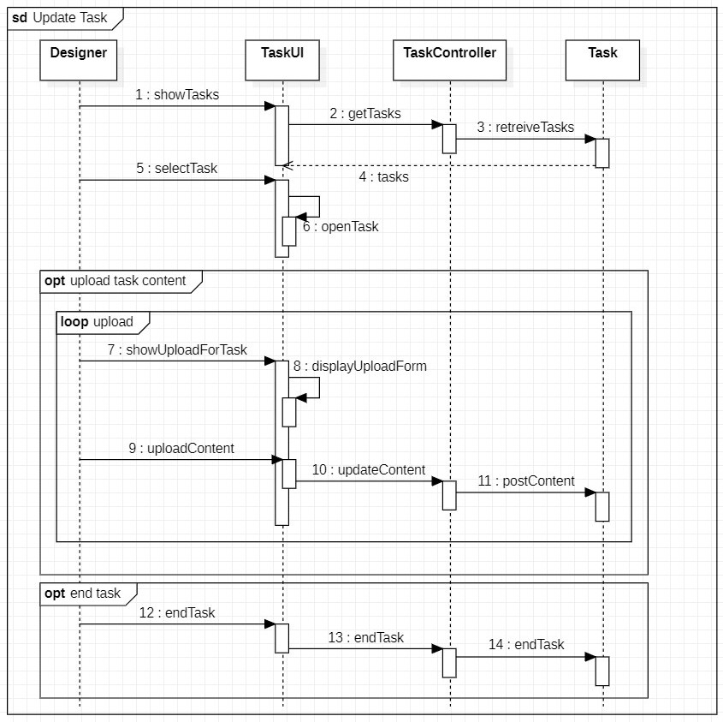
Designer

Slide 12
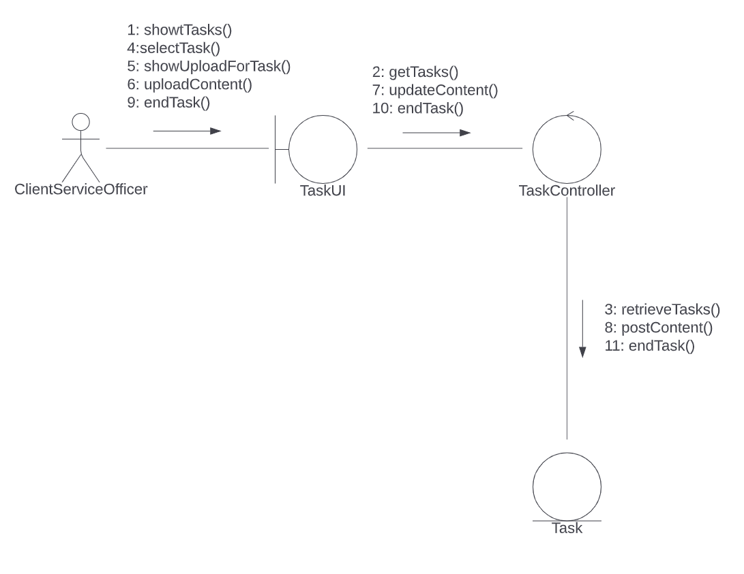

Slide 13
Finishing Project

Slide 14
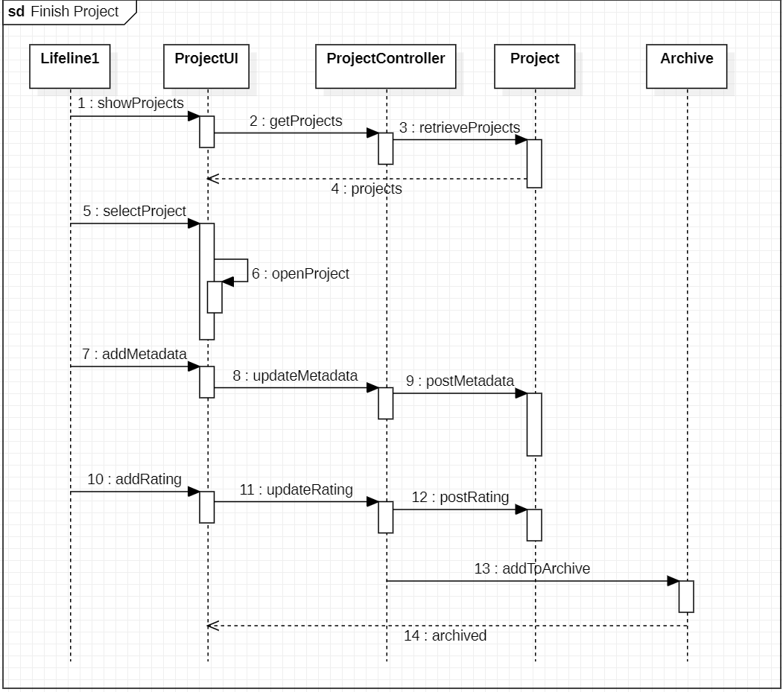
Client Service Officer

Slide 15
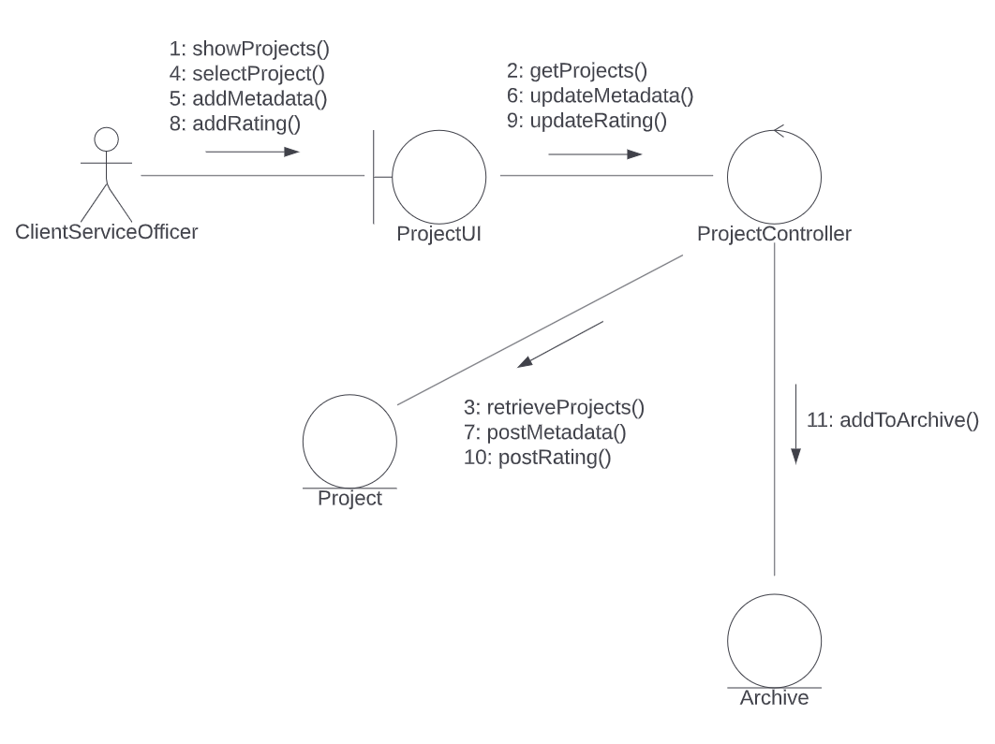

Slide 16
Search & Filter

Slide 17
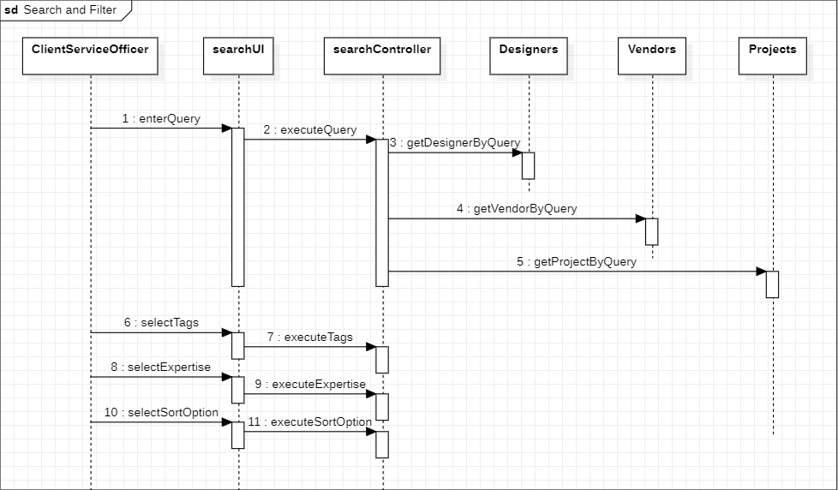
Client Service Officer

Slide 18
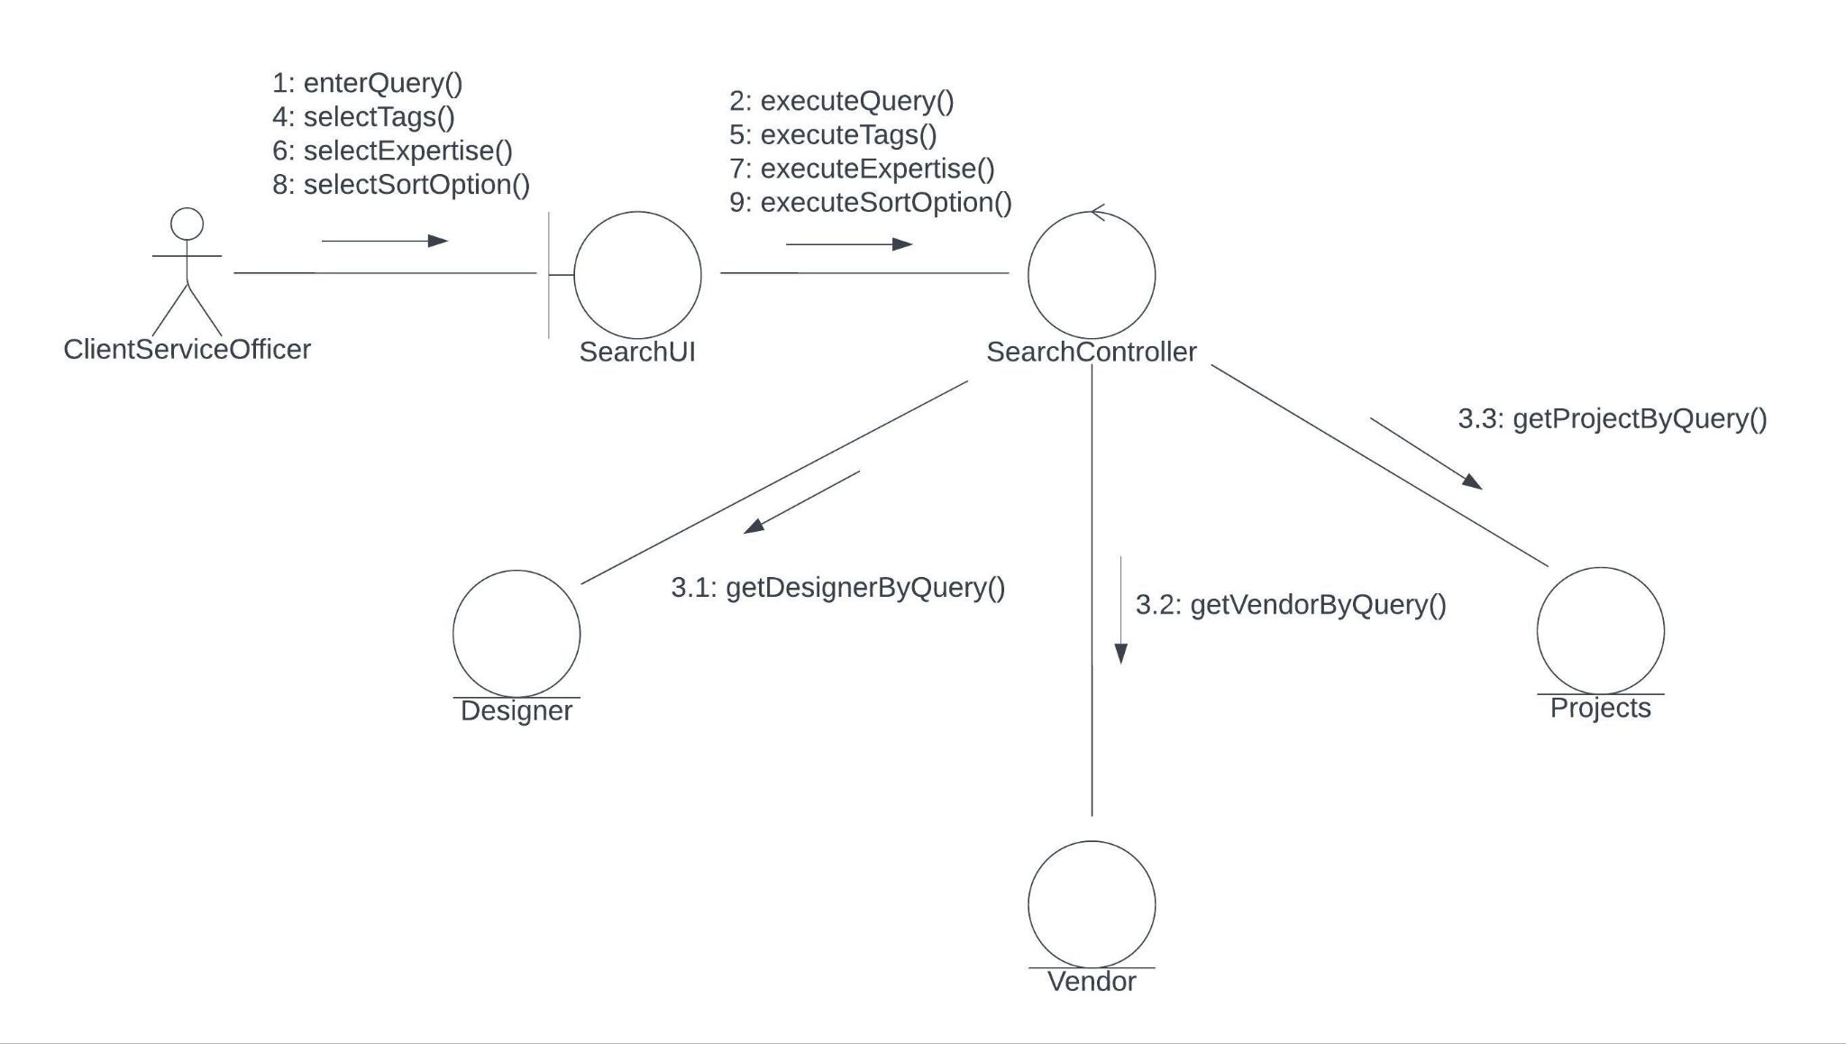

Slide 19
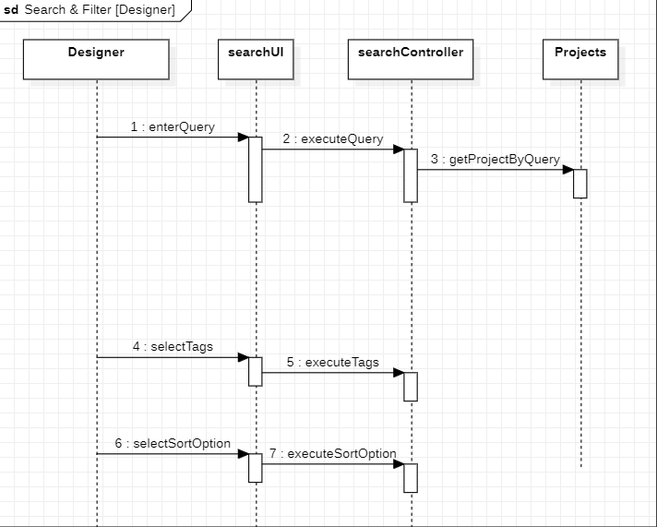
Designer

Slide 20
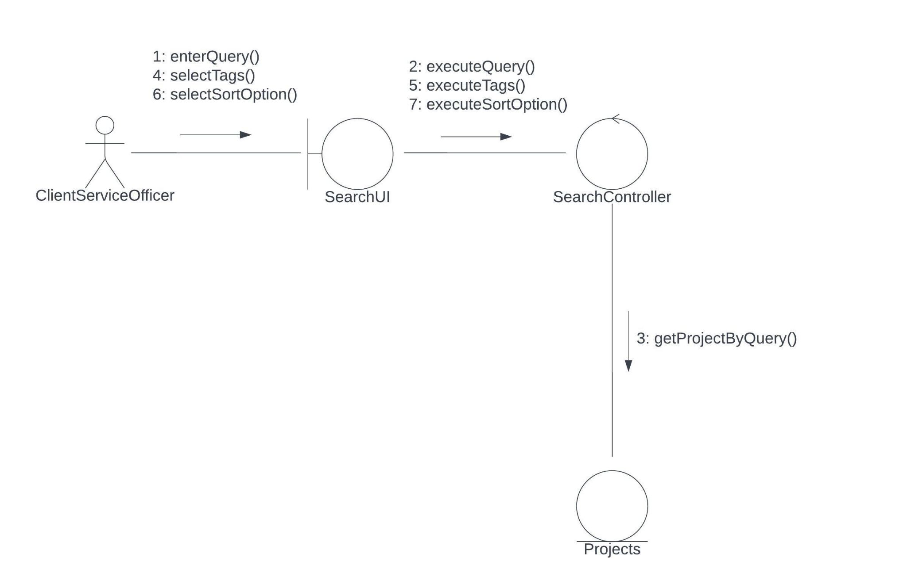
Designer

Slide 21
State Diagrams

Slide 22
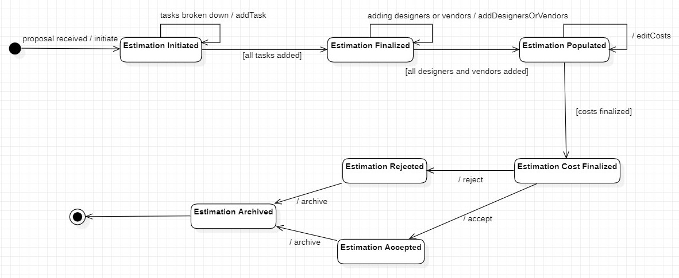
Estimation

Slide 23
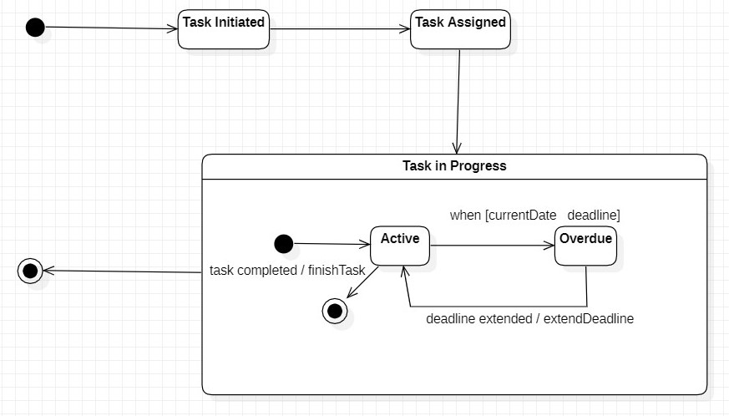
Task
[designer assigned]
[task started]
>

Slide 24
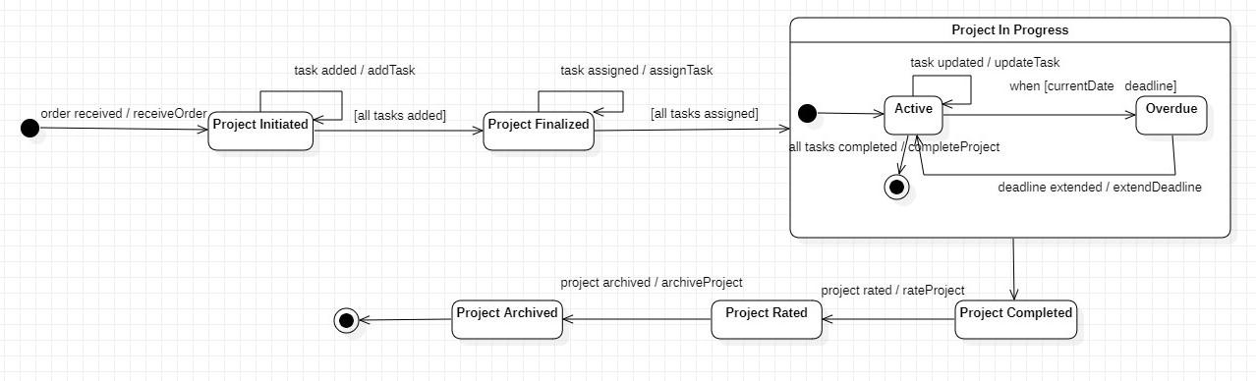
Project
>

Slide 25
Thank You.

